Slide 1
LEWIS STRUCTURES (ELECTRON DOT DIAGRAMS)
Lewis Structures: valence electrons in an atom, molecule or ion are shown as a dot or cross (a line can be used to represent a pair of electrons but this is usually reserved for molecules or polyatomic ions).
Examples:
Atoms
hydrogen aluminium bromine
Monatomic ions
sodium strontium phosphide iodide

Slide 2
Covalent molecules - atoms within a covalent molecule share electrons to achieve a noble gas configuration (in general, eight electrons in the valence shell which is called the octet rule). In sharing these electrons, the bonds formed can be single (sharing two electrons), double (sharing four electrons) or triple (sharing six electrons).
chlorine carbon dioxide hydrogen cyanide
Polyatomic Ions - atoms within a polyatomic ion share electrons to achieve a noble gas configuration. Although polyatomic ions contain covalent bonds, they are still ions and, as such, are involved in ionic bonds.
hydroxide nitrate ammonium

Slide 3
Molecular Shapes: Shapes of covalent molecules are due to the repulsions between groups of valence electrons around the central atom. This is known as the valence shell electron pair repulsion (VSEPR) theory. The electrons (and hence, atoms) arrange themselves to minimise repulsion between them.
When determining shapes, double and triple bonds are treated as though they are single bonds (in reality they have a slightly greater impact on repulsion between electron pairs and, as such, impact bond angles).

Slide 4
Example: Draw the Lewis structures of the following molecules and ions and name their shape.
CO, CS₂, CH₂Cl₂, H₂S, PF₃, O₃, CO₃²⁻, SO₄²⁻, SO₃²⁻

Slide 5
Electronegativity - an atom’s tendency to attract electrons.
Polar bond: occurs when two bonded atoms differ in electronegativities.
The more electronegative atom attracts the electron(s) more strongly, creating an area of slightly negative charge (a negative pole) at that end of the bond, and a slightly positive pole at the other end.
Also known as a bond dipole or polar moment. The greater the difference in the electronegativities of the two atoms, the greater the size of the dipole.
Dipoles can be denoted a number of ways:
δ⁺ δ‒
Polar Bonds and Molecules

Slide 6
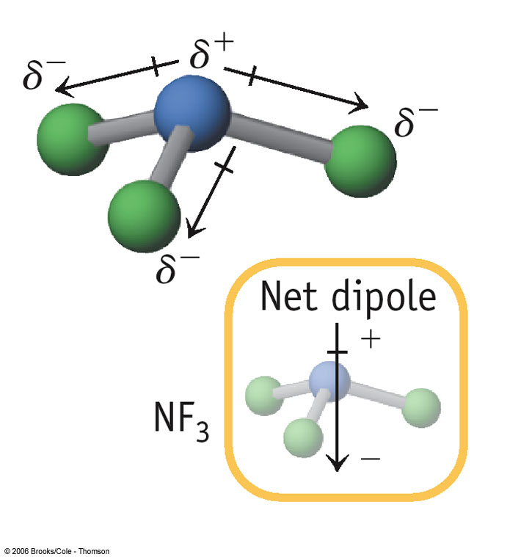
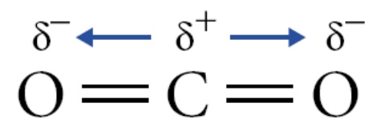
Polar molecule: A molecule will be polar if the vector sum (ie size and direction) of the individual bond dipoles gives an overall net dipole. If there is no net dipole, the molecule is non-polar. A molecule can be non-polar and contain polar bonds.
NF₃
CO₂
(Kucanda 2015)
No net dipole
(Me 2012)

Slide 7
IntRA- And IntermoleculAr forces
Intramolecular forces: the forces present within a molecule (i.e. covalent bonds). They are much stronger than intermolecular forces (as are ionic and metallic bonds).
Intermolecular forces: the forces present between molecules. They are much weaker than intramolecular forces and can be used to explain variations in melting and boiling points, vapour pressure and solubility.
In general, the greater the strength of intermolecular forces, the higher the melting and boiling points and the lower the vapour pressure.

Slide 8
Dispersion Forces – occur between all molecules but are most significant in non-polar substances and monatomic gases.
It is due to the random motion of shared valence electrons which are not symmetrically shared and so can produce a temporary dipole.
This temporary dipole can then induce temporary dipoles in nearby molecules. These dipoles then experience weak electrostatic attractive forces called dispersion forces.
As the induced dipoles are temporary, they are constantly appearing then disappearing and then reappearing somewhere else.

Slide 9
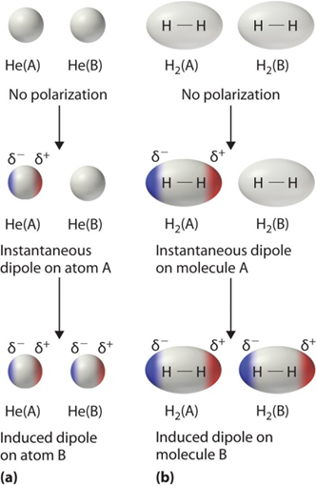
(Larsen n.d.)

Slide 10
Dispersion forces increase in strength with increasing number of electrons. This leads to an increase in melting and boiling points and a decrease in vapour pressure.
Molecule | Melting Point (°C) | Boiling Point (°C)
F₂ | -220 | -188
Cl₂ | -101 | -35
Br₂ | -7 | 59
I₂ | 114 | 184

Slide 11
Similarly, dispersion forces increase in strength for molecules of similar mass that have a greater surface contact between the molecules (i.e. linear molecules experience greater dispersion forces than branched or cyclical analogues).
Molecule | Melting Point (°C) | Boiling Point (°C)
Pentane | -130 | 36
Methybutane | -160 | 28

Slide 12
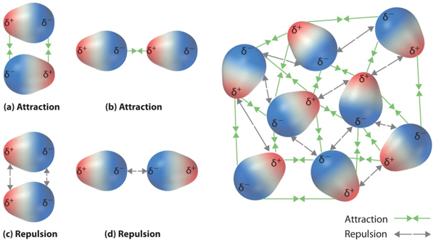
Dipole-Dipole Forces – occur between polar molecules. It is due to the electrostatic attraction between oppositely charged ends of the overall dipole.
(Larsen n.d.)

Slide 13
Although the strength of a dipole moment increases with the increased difference in electronegativities between atoms in a molecule, the dispersion forces become more significant with increasing number of electrons (size of molecule). This adds to the intermolecular forces and increases the melting and boiling points.
Molecule | Melting Point (°C) | Boiling Point (°C)
CH₃F | -138 | -79
CH₃Cl | -97 | -24
CH₃Br | -93 | 3
CH₃I | -66 | 42

Slide 14
Hydrogen Bonding – hydrogen bonding is an extreme form of dipole-dipole forces. It occurs when a hydrogen atom is bonded to a fluorine, oxygen or nitrogen atom in a molecule and it interacts with a non-bonding pair of electrons on another fluorine, oxygen or nitrogen atom in another molecule.
Hydrogen bonding is due to the highly electronegative nature of fluorine, oxygen and nitrogen that have a high charge density due to their relatively small size.

Slide 15
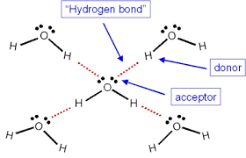
Hydrogen bonding between water molecules

Slide 16
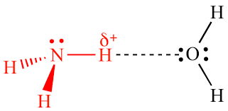
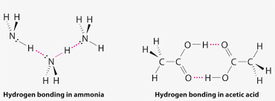
Hydrogen bonding between water and ammonia molecules

Slide 17
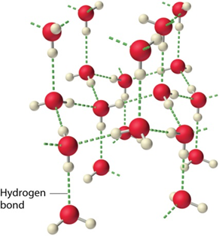
Hydrogen bonding between water molecules
(Larsen n.d.)

Slide 18
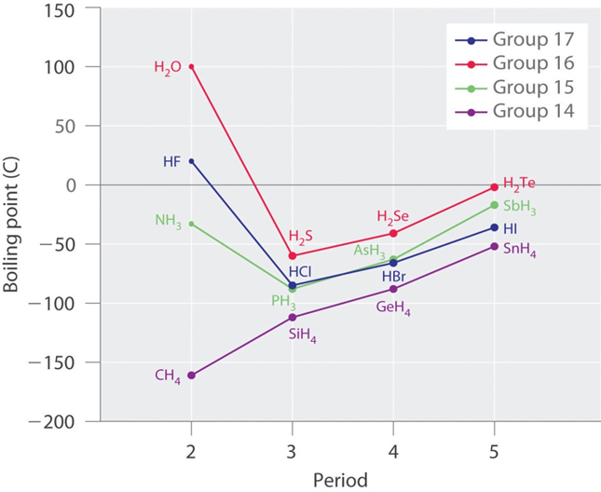
Boiling and melting points of hydrogen bonded substances tend to be much higher than those of similar molecular size that display only dipole-dipole or dispersion forces.
(Larsen n.d.)

Slide 19
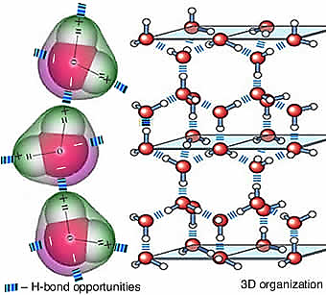
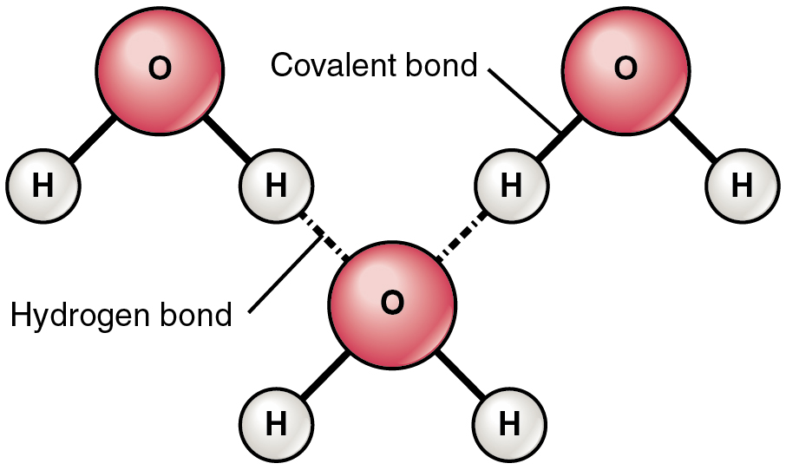
Water has the highest melting point of the substances that are capable of hydrogen bonding because its molecular arrangement allows each water molecule to form up to four hydrogen bonds. HF and NH₃ typically form only two hydrogen bonds with other molecules.
(Schatz n.d.)
(Water, Chemical Bond and Macromolecular Structure 2014)

Slide 20
Surface Tension
https://www.youtube.com/watch?v=KFPvdNbftOY
https://www.youtube.com/watch?v=8fWfErpNX90 (12:00)

Slide 21
Chromatography
Chromatography – an analytical technique used to separate and identify components (or analytes) of mixtures. It can also be used to determine the concentration of these components in the mixture. The principles of the various types of chromatography are the same.
The mixture is placed into a mobile phase (this may be a liquid solvent or a gas stream)
The mobile phase containing the mixture is passed over a stationary phase
The different components in the mixture adsorb to the stationary phase at different points in time depending on the nature of the stationary phase and the analytes in the mixture.

Slide 22
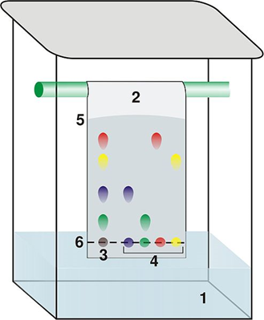
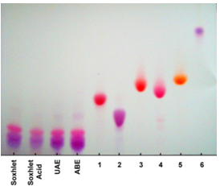
Thin Layer Chromatography (TLC)
1 - solvent
2 – TLC plate
3 – analyte
4 – pure components
5 – solvent front
6 – point of origin
(Dubaj 2006)
(Santos, et al. 2012)

Slide 23
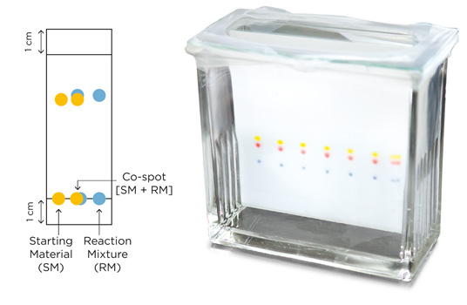
Used for organic mixtures such as plant pigments and drugs.
A thin glass plate is coated with finely powdered alumina, Al₂O₃ or silica SiO₂ which acts as the stationary phase.
The mobile phase is a solvent that will dissolve and separate the components of the mixture. The mobile phase moves up the stationary phase by capillary action.
The TLC plate and solvent are placed in a sealed container to ensure the vapour phase is saturated with gaseous solvent particles and to prevent the solvent evaporating.
(Silicycle 2015)

Slide 24
Due to the difference in polarity of the analytes they are carried up the stationary phase at different rates and adsorb at different points.
The components in the mixture can be identified by their retardation factor, R_{f} where:
R_{f} =
In TLC, the R_{f} of a given substance is not constant as it depends on the nature of the stationary and mobile phases. For this reason a TLC of the different pure substances thought to be present in the mixture needs to be produced under identical conditions in order to obtain comparable R_{f} values.

Slide 25
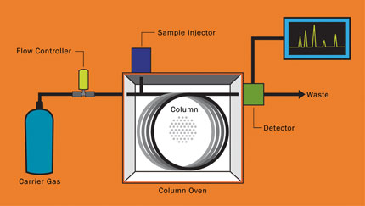
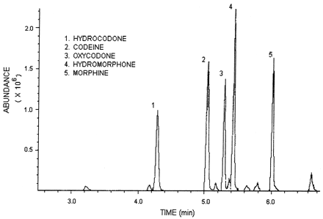
TLC has the advantage of being a relatively simple and inexpensive way of confirming the purity of a mixture.
Gas Chromatography (GC)
(Virginia Tech 2015)
(Broussard, et al. 2001)

Slide 26
Used to identify individual heat stable, relatively small molar mass analytes and their concentrations in complex mixtures.
Mobile phase is an inert carrier gas such as He or N₂.
Stationary phase is a high boiling point non-volatile viscous liquid adsorbed onto solid particles such as silica. This is packed within a long stainless steel coiled column that may be 2-5 mm in diameter and 1.5–100 m in length.
The gas chromatograph consists of a gas supply, high temperature injection chamber, column, detector and recorder.

Slide 27
The liquid mixture to be analysed is injected through a rubber seal and vaporised. The vaporised mixture then travels through the temperature controlled column. The analytes remain either in the mobile phase or stationary phase based on its volatility (tendency to evaporate). Analytes with a higher volatility tend to remain in the mobile phase. These exit (are eluted from) the column quickly and have a smaller retention time.
Analytes can be identified by producing a chromatogram of the pure analyte under the same conditions of column choice, carrier gas, gas flow rate and temperature.

Slide 28
Analyte concentrations can be determined from the height and area of a chromatogram peak when compared to the peaks produced from a set of standards.

Slide 29
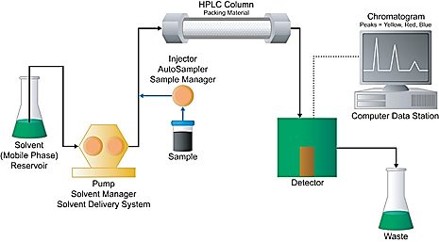
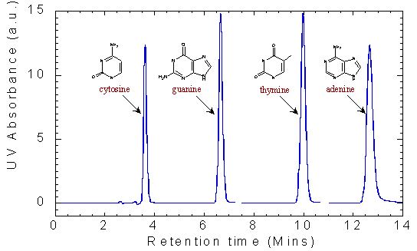
High Performance Liquid Chromatography (HPLC)
(Waters 2015)
(Dublin City University n.d.)

Slide 30
Used to identify individual, relatively large molar mass analytes which are unstable when heated and their concentrations in complex mixtures.
Mobile phase is a non-polar liquid solvent.
Stationary phase is made up fine particles such as SiO₂ that are polar. This is packed within a short stainless steel coiled column that may be 3-5 mm in diameter and 10 – 30 cm in length.
In reverse phase HPLC the stationary phase is non-polar and the mobile phase is polar.

Slide 31
The high performance liquid chromatograph consists of a high pressure pump, sample injection loop, column, detector and recorder.
The liquid mixture to be analysed is injected through an injection loop into a high pressure column of solvent. The sample then travels through the column. The analytes travel at different rates through the stationary phase based on their polarity. Analytes with a higher polarity tend to adsorb on to the stationary phase. These take longer to travel through the column and have a larger retention time.
Analytes can be identified by producing a chromatogram of the pure analyte under the same conditions of column choice, mobile solvent and solvent flow rate.

Slide 32
Analyte concentrations can be determined from the height and area of a chromatogram peak when compared to the peaks produced from a set of standards.
Much of the physical behaviour of gases can be explained using the kinetic theory of gases. This theory is based on the movement of the gas particles which is fundamental in determining the physical properties of gases. The current model is based on the ideal gas.
GASES

Slide 33
Kinetic Theory of Gases
Gases consist of molecules (or atoms in the case of noble gases) that move in continuous, rapid, random, straight-lined motion.
The space between gas particles is so large that the volume of the particles themselves is negligible when compared to the volume the gas occupies.
The forces of attraction and/or repulsion between gas particles are negligible.
All collisions between gas particles are perfectly elastic (ie no net gain or loss of energy).
The average kinetic energy (E_{K} = ½mv²) of the gas particles is proportional to its temperature and is the same for all gases at the same temperature.

Slide 34
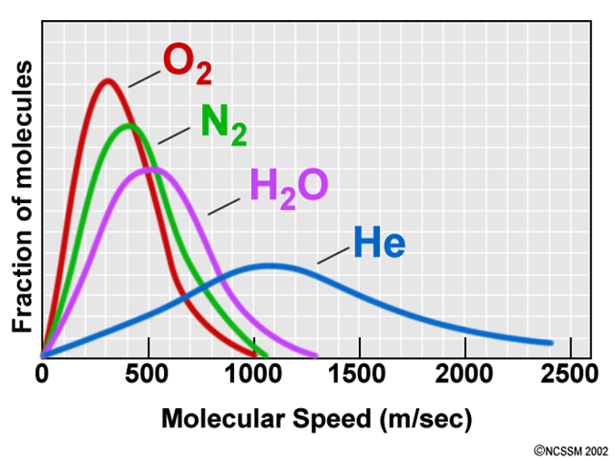
For different gases at the same temperature, as they possess different masses, the velocity of the particles differ.
(North Carolina School of Science and Mathematics n.d.)

Slide 35
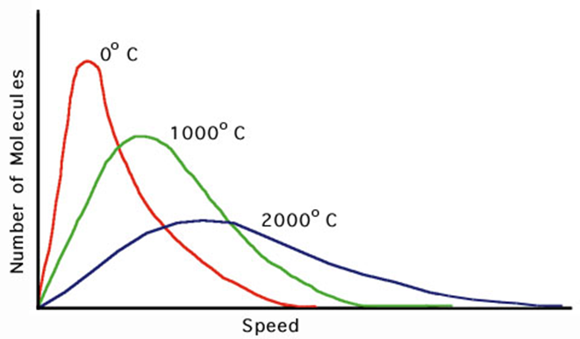
As the temperature of the gas is decreased, the velocity of the particles also decreases.
Theoretically, at low enough temperatures, the particles will cease moving. This lowest theoretical temperature is called absolute zero and is equal to ‒273.15 °C or 0 K (Kelvin). To convert K→°C minus 273.15, to convert °C→K add 273.15
(Casiday and Frey 2000)

Slide 36
The kinetic theory of gases can explain physical properties of gases including:
Gases diffuse – due to their rapid, random, straight-lined motion and have negligible forces of attraction or repulsion between them.
Gases are compressible – due to the very large space between them and the particles possessing negligible volume themselves.
Gases take the shape of the container they are in – due to their rapid, random, straight-lined motion and have negligible forces of attraction or repulsion between them.
Gases have a low density – due to the very large spaces between the particles.

Slide 37
Gases exert pressure – due to their motion, they collide with the container walls (pressure increases with increasing force and frequency of these collisions).
It is important to note that the kinetic theory of gases is based on the notion of an ideal gas. In reality real gases differ from an ideal gas in that real gases:
Exert forces of attraction and repulsion
Occupy volume which can be significant when compared to the volume of the gas as a whole
Real gases approach ideal gases under the conditions of high temperature and low pressure.

Slide 38
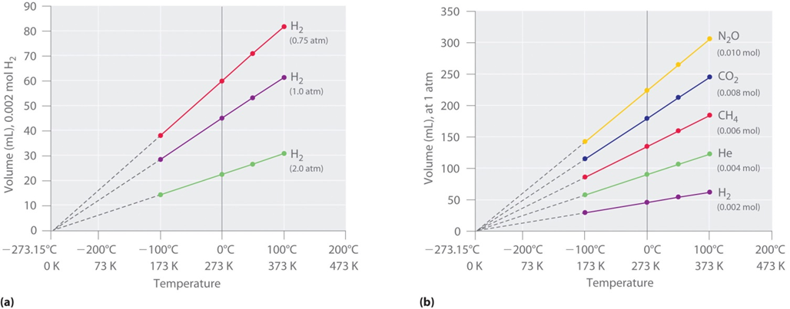

Charles’ law: At constant pressure, the volume of a fixed quantity of gas is directly proportional to its temperature (ie V $∝$ T).
(Schmitz 2012)

Slide 39
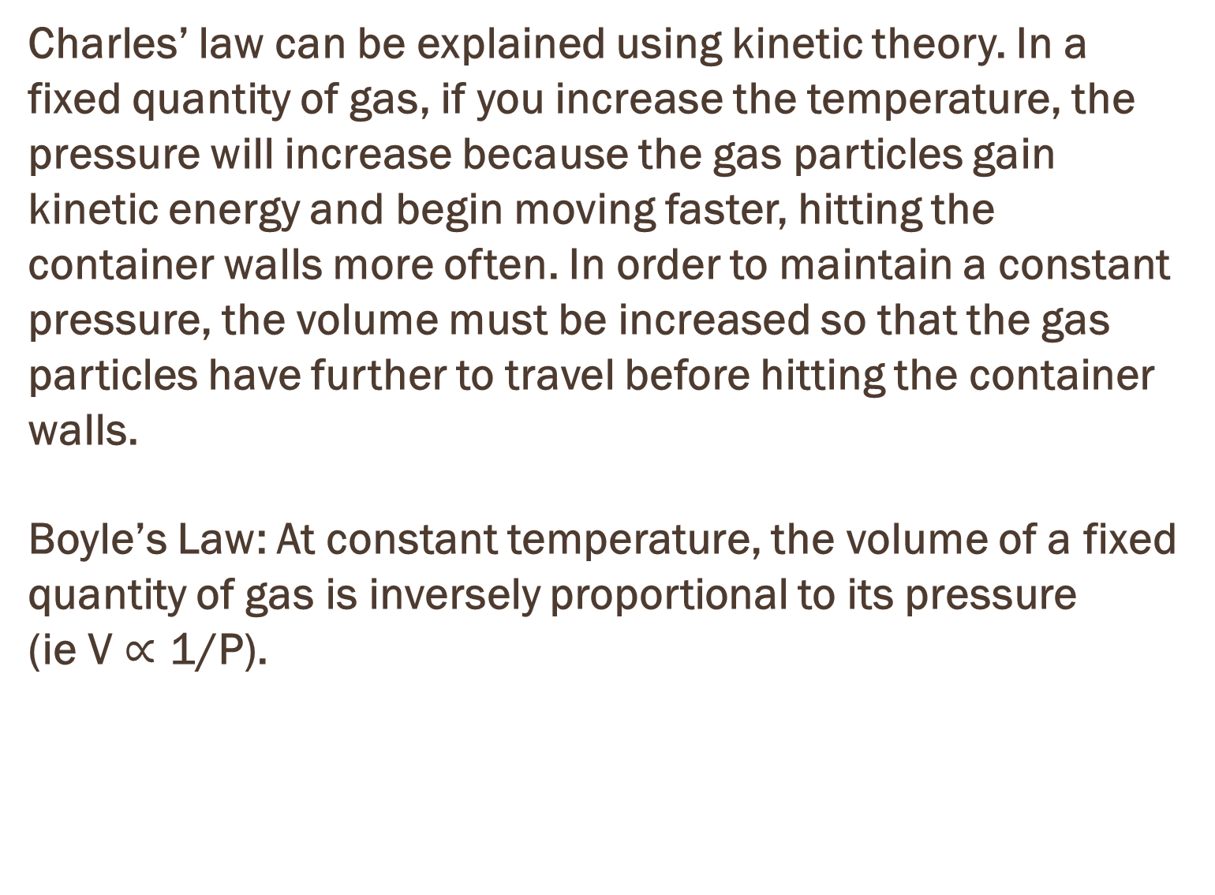
Charles’ law can be explained using kinetic theory. In a fixed quantity of gas, if you increase the temperature, the pressure will increase because the gas particles gain kinetic energy and begin moving faster, hitting the container walls more often. In order to maintain a constant pressure, the volume must be increased so that the gas particles have further to travel before hitting the container walls.
Boyle’s Law: At constant temperature, the volume of a fixed quantity of gas is inversely proportional to its pressure (ie V $∝$ 1/P).

Slide 40
Boyle’s law can be explained using kinetic theory. In a fixed quantity of gas at constant temperature, if you increase the volume, the pressure will decrease because the gas particles have further to travel before hitting the container walls. The opposite is true if you decrease the volume.
At constant volume, the pressure of a fixed quantity of gas is directly proportional to its temperature.
This can be explained using kinetic theory. If the volume of a fixed quantity of gas is constant as the temperature is increased, the average kinetic energy of the particles increases. This means the velocity of the particles will increase and they will hit the walls of their container more often and with greater force which increases the pressure.

Slide 41
The previous relationships between gas pressure and volume and temperature have assumed a fixed amount of gas and, therefore, the number of particles or moles of gas. This suggests that if the pressure and temperature are kept constant then the number of moles of gas is directly proportional to volume. This is true of all gases because volume is dependent on number of particles, not type of particles.

Slide 42
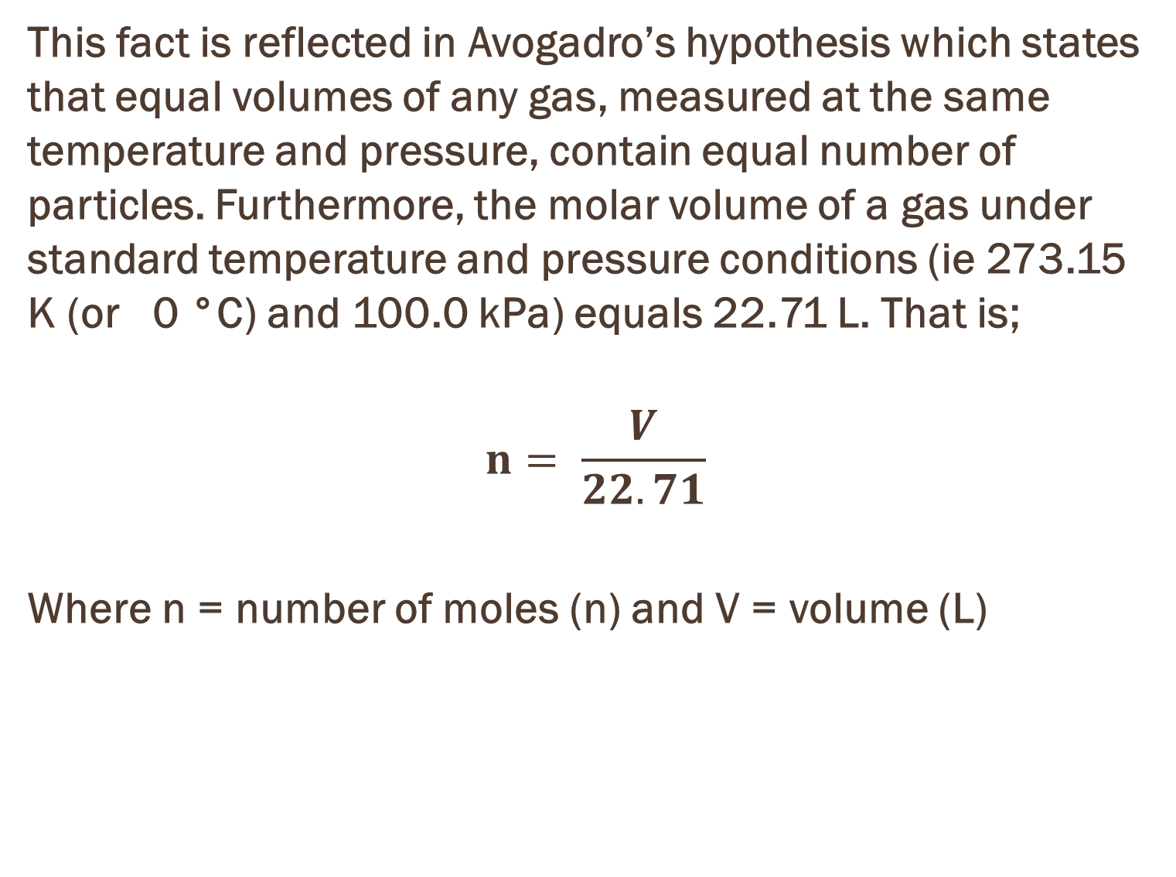
This fact is reflected in Avogadro’s hypothesis which states that equal volumes of any gas, measured at the same temperature and pressure, contain equal number of particles. Furthermore, the molar volume of a gas under standard temperature and pressure conditions (ie 273.15 K (or 0 °C) and 100.0 kPa) equals 22.71 L. That is;
$$n= \frac{V}{22.71}$$
Where n = number of moles (n) and V = volume (L)

Slide 43
Bibliography
Broussard, LA, LC Presley, M Tanous, and C Queen. "Improved Gas Chromatography-Mass Spectrometry Method for Simultaneous Identification and Quantification of Opiates in Urine as Propionyl and Oxime Derivatives." Clinical Chemistry. January 2001. http://www.clinchem.org/content/47/1/127.full (accessed August 10, 2015).
Casiday, R, and R Frey. "Gas Laws Save Lives: The Chemistry Behind Air Bags." Washington University in St. Loius. October 2000. http://www.chemistry.wustl.edu/~edudev/LabTutorials/Airbags/airbags.html (accessed August 2, 2015) (accessed August 10, 2015).
Dubaj. "Structural Biochemistry/Chromatography/Thin Layer." Wikibooks. April 29, 2006. https://en.wikibooks.org/wiki/Structural_Biochemistry/Chromatography/Thin_Layer (accessed August 1, 2015). (accessed August 10, 2015).
Dublin City University. "High Performance Liquid Chromatography." Dublin City University. n.d. http://www.dcu.ie/chemistry/ssg/hplc.shtml (accessed August 10, 2015).
Kucanda, K. "Why Does Geometrical Symmetry Cancel Out the Polarity of Molecules Such as CO2?" Quora. January 12, 2015. http://www.quora.com/Why-does-geometrical-symmetry-cancel-out-the-polarity-of-molecules-such-as-CO2 (accessed August 10, 2015).
Larsen, D. "11.2 Intermolecular Forces." UCDavis Chemwiki. n.d. http://chemwiki.ucdavis.edu/Wikitexts/UC_Davis/UCD_Chem_2B/UCD_Chem_2B%3A_Larsen/Unit_II%3A_States_of_Matter/Intermolecular_Interactions/11.2%3A_Intermolecular_Forces (accessed August 1, 2015). (accessed August 10, 2015).
Me, K. "K-Me Article." K-Me Article. 2012. http://www.satriwit3.ac.th/external_newsblog.php?language=En&usid=&links=1403 (accessed AUgust 10, 2015).
North Carolina School of Science and Mathematics. "Gases." Teachers' Instructional Graphics Educational Resource. n.d. North Carolina School of Science and Mathematics. "Gases." Teachers' Instructional Graphics Educational Resource. n.d. http://www.dlt.ncssm.edu/tiger/chem3.htm (accessed August 2, 2015). (accessed August 10, 2015).
Santos, DT, RN Cavalcanti, MA Rostagno, CL Queiroga, MN Eberlin, and MAA Meireles. "Extrcation of Polyphenols and Anthocyanins from the Jambul (Syzygium cumini) Fruit Peels." Scientific and Academic Publishing. 2012. http://article.sapub.org/10.5923.j.fph.20130301.02.html#Ref (accessed August 10, 2015).
Schatz, P. "Organic Compounds Essential to Human Functioning." Anatomy Book. n.d. http://philschatz.com/anatomy-book/contents/m46008.html (accessed August 10, 2015).
Schmitz, A. "Relationships Among Pressure, Temperature, Volume and Amount." 2012 Book Archive. December 29, 2012. http://2012books.lardbucket.org/books/principles-of-general-chemistry-v1.0/s14-03-relationships-among-pressure-t.html (accessed August 2, 2015). (accessed August 10, 2015).
Silicycle. "Siliaplate - TLC Practical Guide." Silicycle. 2015. http://www.silicycle.com/products/thin-layer-chromatography-tlc-plates/siliaplate-1 (accessed August 10, 2015).
Virginia Tech. "Shrinking Lab Equipment onto a Chip." Bradley Department of Electrical and Computer Engineering . 2015. http://www.ece.vt.edu/news/ar08/gcmatrix.html (accessed August 10, 2015).
"Water, Chemical Bond and Macromolecular Structure." Being Biofundamental. May 10, 2014. http://virtuallaboratory.colorado.edu/Biofundamentals/lectureNotes-Revision/Topic2B_Water.htm (accessed August 10, 2015).
Waters. "How Does High Performance Liquid Chromatography Work." Waters - The Science of What's Possible. 2015. http://www.waters.com/waters/en_AU/How-Does-High-Performance-Liquid-Chromatography-Work%3F/nav.htm?cid=10049055&locale=en_AU (accessed August 10, 2015).

